Slide 1
Email Administration Application
By :- Hari Priya.V

Slide 2
Contents
Introduction
System Requirements
Implementation
Conclusion

Slide 3
Introduction
The objective of Email Administration Application is to allow the employee of organization to enter first name, last name, department and organisation so that email will be auto-generated based on provided details.
Auto-generated password will also be provided which can be updated later if required.

Slide 4
System Requirements
Operating System - Windows 10.
Platform – Eclipse.
Language – Core Java, MySQL.

Slide 5
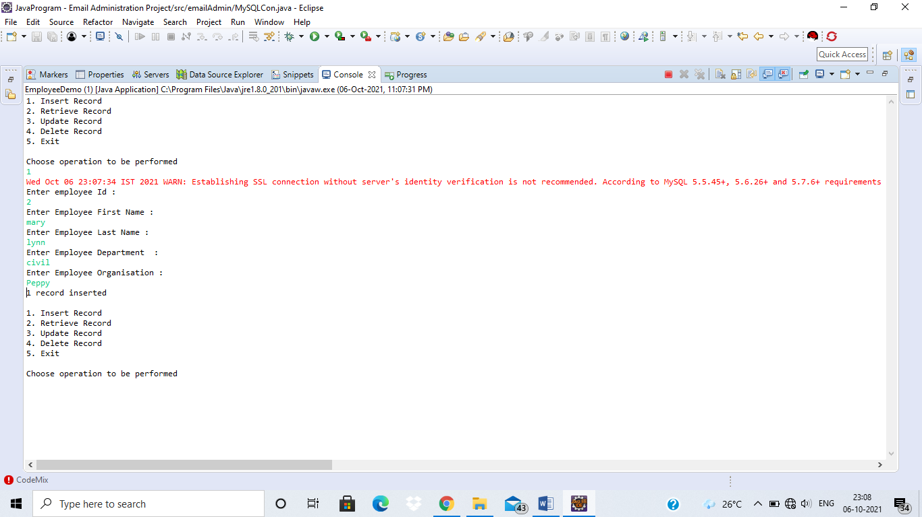
Insert Page

Slide 6
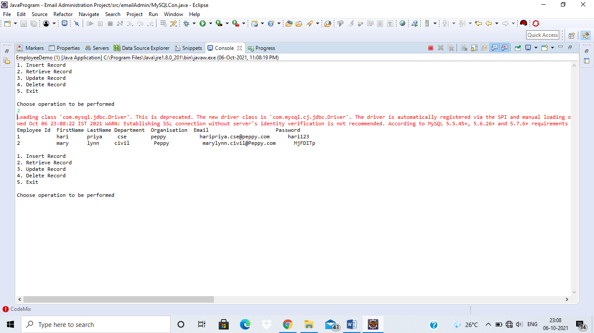
Retrieve Page

Slide 7
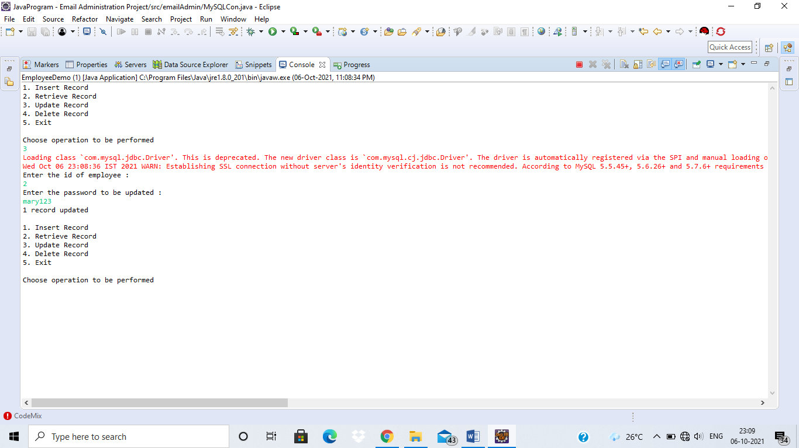
Update Page

Slide 8
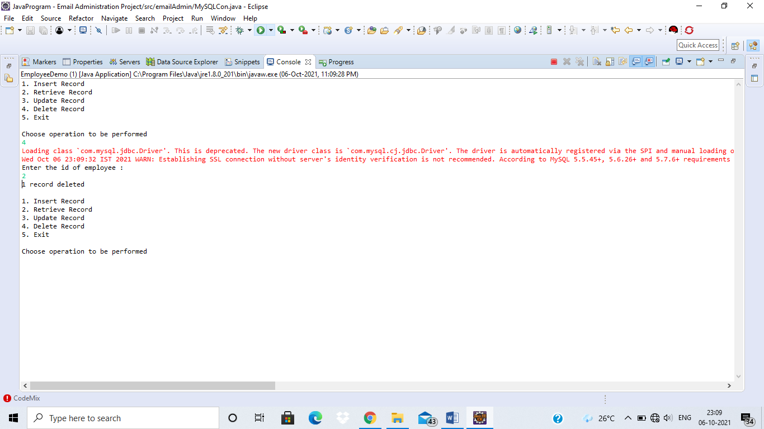
Delete Page

Slide 9
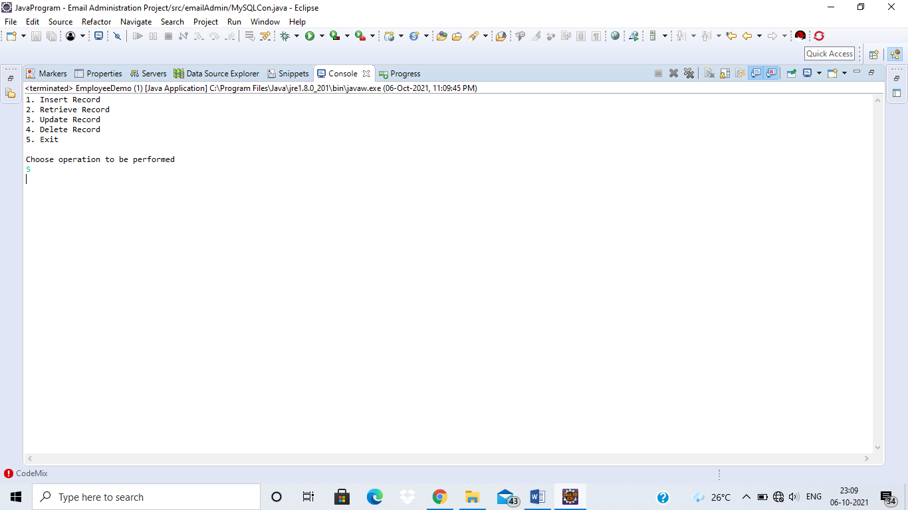
Exit Page

Slide 10
CONCLUSION
Email Administration Application will provide email and password based on the details provided so that the organisation can uniquely access the email address for communicating and also provides an option for changing password.

